Slide 1
COMMON CONGENITAL ANOMALIES

Slide 2
General objective
To identify different congenital anomalies that are present at birth.

Slide 3
Specific objectives:
List the possible causes of fetal malformations.
Define some common congenital anomalies in the newborn infant.
Describe some of the surgery related differences between infants and adults.
Outline important aspects in the pre and post operative care of paediatric patients.
Discuss specific pre and post operative care of a child with the following: cleft lip, cleft palate, oesophageal atresia and pyloric stenosis.

Slide 4
Causes of fetal malformation:
Drugs
Radiation
Viruses
Genetic traits

Slide 5
Common congenital anomalies in the newborn
Respiratory system:
- Laryngeal stridor
- Choanal atresia
Gastrointestinal system:
- Anomalies of the mouth (cleft lip & cleft palate).
- Anomalies of the esophagus (esophageal atresia & chalasia of the esophagus).
Anomalies of the stomach and duodenum:
- pyloric stenosis
- duodenal obstruction
- hiatus hernia
Anomalies of the intestine:
- Imperforated anus.
- Omphalocele.
- Intestinal atresia.
- Diaphragmatic hernia.
- Hirschsprung’s disease (congenital aganglionic megacolon)
- Intussusception

Slide 6
Congenital anomalies of the urinary system:
Epispadias
Hypospadias
Phimosis
Hydrocele
Inguinal hernia
Polycystic kidney
Wilm’s Tumor (Embryoma)

Slide 7
Epispadias
Mutual opening located on dorsal or superior surface of the penis.

Slide 8
Hypospadias
Urethral opening located behind glands penis or anywhere along ventral (lower) surface of penis shaft.

Slide 9
N.B
Infants with epispadias and hypospadias should not be circumcised before repair of the defect because the surgeon may wish to use a portion of the foreskin for plastic repair.

Slide 10
Phimosis
Narrowing or stenosis of preputial opening of foreskin.
(in severe cases: circumcision or vertical division and transverse, suturing of foreskin)

Slide 11
Hydrocele
Fluid in scrotum.
Therapeutic management is surgical repair indicated if spontaneous resolution not accomplished in 1 year.

Slide 12
Inguinal hernia:
Protrusion of abdominal contents through inguinal canal into the scrotum.
Therapeutic management includes: detected as painless inguinal swelling of variable size surgical closure of inguinal defect.

Slide 13
Polycystic kidney:
The infant has enlarged kidneys filled with cysts at birth
If the condition is bilateral, the infant will not pass urine but if it is unilateral the condition may be missed until later in life.

Slide 14
Wilm’s Tumor (Embryoma)
It is a malignant tumor of the kidney that arises from an embryonic structure present in the child before birth;
The tumor is felt as an abdominal mass. It is important that the necessary for diagnosis because handling appears to increase the danger of metastasis.

Slide 15
Skeletal defects affecting the nervous system:
Spina Bifida
Spina Bifida Occulta
Meningocele
Meningomyelocele
Hydrocephalus

Slide 16
Spina Bifida
It is a defective closure of the vertebral column.
It is more common in the lumbo sacral region. It has varying degree of tissue protrusion through the bony cleft.

Slide 17
Spina Bifida Occulta
Usually the 5th lumber and 1st sacral vertebrae are affected with no protrusion of interspinal contents the spinal cord and its cover the skin over the defect may reveal a dimple, small fatty mass or a tuft of hair.

Slide 18
Meningocele
Is a protrusion through the spina bifida, which forms a soft, saclike appearance along the spinal axis and contains spinal fluid and meninges within the sac and covered with skin.

Slide 19
Meningomyelocele
Is a more serious defect in which the spinal cord and / or nerve roots as well as meningocele covering protrude through the spina bifida.
The degree and extent of neurogenic defect depend on the level of the defect. The higher the level the greater the defect. If in the lumbosacral, the usual of the defect is associated with a flaccid paralysis of the lower extremities, absent sensation to the level of the lesion and loss of bowel and bladder control.

Slide 20
Hydrocephalus
The abnormal increase in cerebrospinal fluid volume within the intracranial cavity due to a defect in the cerebrospinal fluid drainage system, intracranial pressure increases, the scalp veins dilate, and the cranial suture begin to separate.

Slide 21
Orthopedic Anomalies:
Clubfoot: flexion at the ankle with inversion of the heel and fore foot.
Torticollis: is a condition in which there is a lateral inclination and a rotation of the head away from the midline of the body with limitation of the range of motion of the neck.
Congenital dislocation of the hip: in this condition the femur head is completely dislocated from the acetabulum. The infant shows limited ability to abduct the hip, asymmetry of the gluteal skin folds and inguinal creases, and shortening of the affected leg.

Slide 22
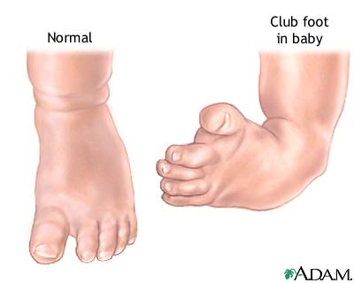
Clubfoot

Slide 23
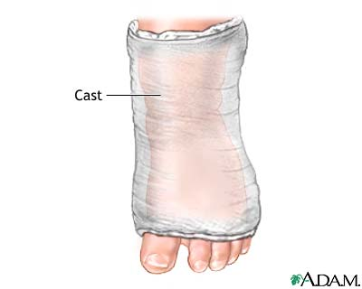
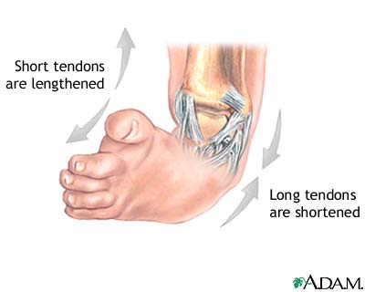
Surgical repair

Slide 24
Surgery related differences between young children and adults:
The metabolic rate of the infant and young children is much greater proportionately than that of adult. Children are growing and need to be fed more frequently.
The body tissues of the child heal quickly because of his rapid rate of metabolism and growth.
The child usually needs proportionately less analgesic than adult patient to obtain relative comfort after surgical procedures.
The child lacks the reserve physical resources that are available to the adult. His general condition may change very rapidly.
Abnormal fluid loss is more serious in the infant and young child than in the adult. Fluid intake and out-put must be calculated very carefully.

Slide 25
General aspects of pre and post operative paediatric care:
Critically ill newborn babies need to be transported to medical centres or paediatric hospitals. Transfer of those babies need to be safe to avoid any deterioration of the infant’s condition.

Slide 26
Transportation of the newborn:
Portable incubator with available oxygen supply.
Equipment for suctioning.
Paediatric nurse should be available during the transfer.
All pertinent infant information should accompany the infant as he goes from one health agency to another.

Slide 27
Pre-operative care:
Psychological preparation of the child.
Except in emergency situations, children should preferably be free from respiratory complications and signs of malnutrition.
Nothing per mouth should be provided to the child pre-operatively (duration depends on child’s age).
The incision over or the part involved in surgery must be washed and inspected. Shaving may be needed.
The mouth should be checked for loose teeth or for dentures (particularly in children of 6-8 yrs old). Any missing teeth should be charted in child’s record.
Remove batteries and pins from the child’s hair.

Slide 28
Clothing should be warm and loose. The child should be dressed in a hospital gown and under pants only.
Check the child’s identification band to see that is eligible and secure.
Pre-medication: sedatives and analgesics are usually given 2 hrs before surgery except in emergencies.
Urination and bowel movements should be charted (enemas are not done routinely unless required).
Nostrils should be cleaned before surgery.
Allow the child to keep his toy till he is under the aesthetic.
Parents should be allowed to accompany their children to the operation site if they so desire.

Slide 29
Post-operative care:
Vital signs
Airway patency
Warm cot or incubator
Side-lying position
Condition and placement of dressing
Check and mark any apparent drainage from wound
IV fluids monitoring (rate, possible infiltration)
Proper handling of the child
Right use of restraints
Urinary catheter care
Skin colour and temprature
Signs of shock
Time of starting oral fluids
Diet modification according to child’s age
Use of sedatives as prescribed
Encouragement of early ambulation when appropriate

Slide 30
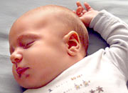
Anomalies of the mouth
Cleft lip
Cleft palate

Slide 31
Definition of cleft lip:
A cleft lip is an abnormal opening in the middle of the upper lip.
A cleft lip is a separation of the two sides of the lip.
It usually looks like a gap in the skin of the upper lip.
It is a birth defect.
It is the most common birth defect of the head and face.
It can happen on one side of the lip (unilateral cleft lip) or both sides of the lip (bilateral cleft lip).

Slide 32
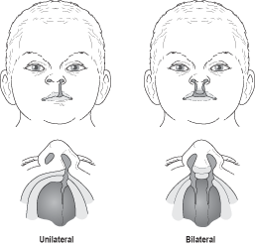

Slide 33
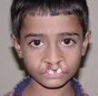
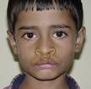


Slide 34
What causes it?
We do not know what causes cleft lip.
Studies show that it could be caused by both:
Genes
Environment during pregnancy
Drugs
Infections or illnesses
Smoking
Drinking

Slide 35
Definition of cleft palate:
A cleft palate is an opening in the roof of the mouth (palate).

Slide 36
Clinical manifestations:
Observable defects

Slide 37
Cleft lip repair is usually done within 6 to 12 weeks of age.
Cleft palate repair is generally postponed until later to take advantage of the palatal changes that occur with normal growth.
Most surgeons repair a cleft palate between 9 months to 1 year before the child develops faulty speech habits.

Slide 38
Diagnostic Evaluation:
Readily apparent by observation and palpation (cleft palate)

Slide 39
Objectives of therapeutic management:
Close defects surgically at the appropriate age.
Prevent the complications.
Habilitate for optimum use of residual impairments.
Facilitate normal growth and development of the child.

Slide 40
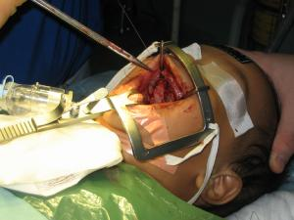
Closing a palate

Slide 41
Nursing care plan for infant with cleft lip and /or palate repair:
Pre-operative care
Nursing diagnosis
Goal
Interventions
Expected outcome

Slide 42
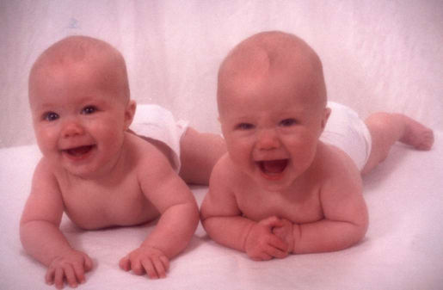
Nursing Diagnosis:
Altered nutrition less than body requirements related to difficulty in eating.

Slide 43
Goal:
Nurse: provide adequate nutritional intake.
Patient: will receive optimum nutrition.

Slide 44
Interventions:
Administer diet appropriate for age (specify).
Modify feeding techniques to adjust to defect.
Hold the child in upright position.
Use special feeding appliances.
Bubble frequently.
Assist mother with breast-feeding if this is mother’s preference.

Slide 45
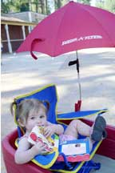
Expected outcome:
Infant consumes an adequate amount of nutrients (specify the amount).
Infant exhibits appropriate weight gain.

Slide 46

Nursing Diagnosis:
High risk for altered parenting related to infant with a highly visible physical defect.

Slide 47
Goal:
Nurse: facilitate family’s acceptance of infant.
Patient (family): will demonstrate acceptance.

Slide 48
Interventions:
Allow expression of feelings.
Convey attitude of acceptance of infant and family.
Indicate by behaviour that child is a valuable human being.
Describe results of surgical correction of defect (use photographs of satisfactory results).
Arrange meeting with other parents who have experiences of similar situations and coped successfully.

Slide 49
Expected outcome:
Family discusses feelings and concerns regarding child’s defect, its repair and future prospects.
Family exhibits an attitude of acceptance of infant.

Slide 50
Nursing care plan for infant with cleft lip and /or palate repair:
Post-operative care
Nursing diagnosis
Goal
Interventions
Expected outcome

Slide 51
Nursing Diagnosis:
High risk for trauma related to surgical procedure, dysfunctional swallowing.

Slide 52
Goal 1:
Nurse: prevent trauma to suture line.
Patient: will experience no trauma to operative site.

Slide 53
Interventions:
Position on back or side (CL).
Maintain lip protective device (CL).
Use non-traumatic feeding techniques.
Restrain arms to prevent access to operative site. (use jacket restraints on older infant).

Slide 54
Interventions (continued)
Avoid placing objects in the mouth following cleft palate repair (suction catheter, tongue depressor, straw, pacifier, small spoon).
Prevent vigorous and sustained crying.
Cleans suture line gently after feeding and as necessary in manner ordered by surgeon (CL).
Teach cleansing and restraining procedures, especially when infant will be discharged before suture removal.

Slide 55

Expected outcome:
Operation site remains un-damaged.

Slide 56
Goal 2:
Nurse: prevent aspiration of secretions.
Patient: will exhibit no evidence of aspiration.

Slide 57
Intervention:
Position to allow for drainage of mucus (partial side-lying position, semi-fowler position).

Slide 58
Expected outcome:
Child manages secretions without aspiration.

Slide 59
Nursing Diagnosis:
Altered nutrition; less than body requirements related to physical defect, surgical procedure.

Slide 60
Goal 1:
Nurse: provide adequate nutrition intake.
Patient will receive optimum nutrition.

Slide 61
Interventions:
Administer diet appropriate for age.
Involve family in determining best feeding methods.
Modify feeding techniques to adjust to defect:
- Feed in sitting position.
- Use special appliances.
- Encourage frequent bubbling.
- Assist with breast-feeding if method of choice.
Teach feeding and suctioning techniques to family.
Monitor IV fluids (if prescribed).

Slide 62
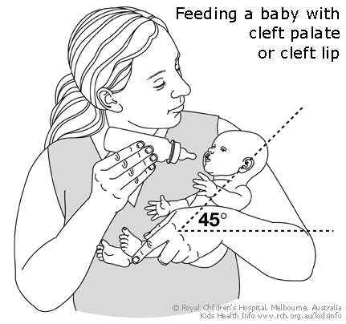

Slide 63
Expected outcome:
Infant consumes an adequate amount of nutrients (specify amount).
Family demonstrates ability to carry out postoperative care.

Slide 64
Nursing Diagnosis:
Pain related to surgical procedures.

Slide 65
Goal:
Nurse: Relive discomfort.
Patient: will experience optimum comfort level.

Slide 66
Interventions:
Administer analgesics and/or sedatives as ordered.
Remove restraints periodically while supervised.
Provide cuddling and tactile stimulation.
Involves parents in infant’s care.
Apply developmental interventions appropriate for infant’s level and tolerance.

Slide 67
Expected outcome:
Infant appears comfortable and rests quietly.

Slide 68
Nursing Diagnosis:
Altered family process related to child with a physical defect.

Slide 69
Goal:
Nurse: support the family.
Patient: will receive adequate support.

Slide 70
Interventions:
Be available to family.
Listen to family members singly or collectively.
Allow for expression of feelings including feeling of guilt and helplessness.
Refer to community agencies to provide assistance (financial & social support).
Refer to genetic counselling if appropriate.
Help family learn to expect feelings of frustration and anger toward child & its impact on parenting.

Slide 71
Interventions (continued):
Assist family in problem solving.
Encourage interaction with other families who have a similarly affected child.
Provide information regarding support groups.
Help families learn when to accept and when to fight.

Slide 72
Expected outcome:
Family maintains contact with health providers.
Family demonstrates an understanding of the needs of the child and the impact of condition will have on them.
Problems are dealt with early.
Family becomes involved with local agencies and support.

Slide 73
Thank you

